Slide 1
Murach’s Modern JavaScript
Chapter 12
How to work with objects

Slide 2
Objectives
Applied
Use object literals to define objects.
Use classes to define objects.
Create and use JavaScript libraries.
Create private properties and methods.
Create accessor properties.
Create static properties and methods.
Create and use nested objects.
Use a generator function to make an object iterable.

Slide 3
Objectives (continued)
Knowledge
Distinguish between object literals and classes.
Explain how two variables can refer to the same object.
Define encapsulation and describe one of its benefits.
Distinguish between data properties and accessor properties.
Distinguish between inheritance and object composition and describe when you would use each technique.
Describe how to create and use cascading methods.
Describe how you can destructure an object.

Slide 4
An object literal with two properties and one method
const invoice = { // object
taxRate: 0.0875, // property
subtotal: 100, // another property
getTotal() { // method
return this.subtotal + (this.subtotal *
this.taxRate); // this = the object
}
};

Slide 5
Use the dot operator to refer to an object’s properties and methods
console.log(invoice.taxRate); // displays 0.0875
console.log(invoice.subtotal); // displays 100
console.log(invoice.getTotal()); // displays 108.75
Use brackets to refer to an object’s properties and methods
console.log(invoice["taxRate"]); // displays 0.0875
console.log(invoice["subtotal"]); // displays 100
console.log(invoice["getTotal"]()); // displays 108.75

Slide 6
A class that defines an Invoice type
class Invoice {
constructor() {
this.subtotal = null;
this.taxRate = null;
}
getTotal() {
return this.subtotal + (this.subtotal *
this.taxRate);
}
}
Create an object from the Invoice class
const invoice = new Invoice();
invoice.subtotal = 100;
invoice.taxRate = 0.0875;
console.log(invoice.getTotal()); // displays 108.75
What happens if you don’t use the new keyword
const invoice = Invoice(); // TypeError exception

Slide 7
Add parameters to the constructor
class Invoice {
constructor(subtotal, taxRate) {
this.subtotal = subtotal;
this.taxRate = taxRate;
}
getTotal() {
return this.subtotal +
(this.subtotal * this.taxRate);
}
}
Create two Invoice objects
const invoice1 = new Invoice(100, 0.0875);
const invoice2 = new Invoice(1000, 0.07);
console.log(invoice1.getTotal()); // displays 108.75
console.log(invoice2.getTotal()); // displays 1070

Slide 8
Add a property to an existing object
invoice.customerId = 156;
Add a method to an existing object
invoice.getSalesTax = function() {
return this.subtotal * this.taxRate;
};
Modify a method of an object
invoice.getTotal = function() {
return this.subtotal + this.getSalesTax();
};
Remove a property from an object
delete invoice.taxRate;

Slide 9
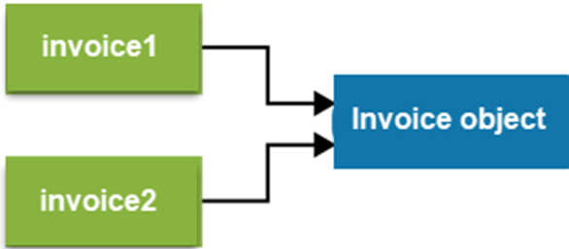
Create two references to the same object
const invoice1 = new Invoice(100, 0.0875);
const invoice2 = invoice1;
invoice2.taxRate = 0.07;
console.log(invoice1.taxRate); // displays 0.07
Two references to the same object

Slide 10
The benefits of JavaScript libraries
They let you group related functionality in a single file.
They make your code easier to understand, maintain, and reuse.
They encourage the separation of concerns.

Slide 11
The lib_invoice.js file
"use strict";
class Invoice {
constructor(subtotal, taxRate) {
this.subtotal = subtotal;
this.taxRate = taxRate;
}
getSalesTax() {
return this.subtotal * this.taxRate;
}
getTotal() {
return this.subtotal + this.getSalesTax();
}
}

Slide 12
The index.html file
...
<body>
...
<script src="lib_invoice.js"></script>
<script src="invoice.js"></script>
</body>
...

Slide 13
The invoice.js file
...
const subtotal =
parseFloat(getElement("#subtotal").value);
const taxRate =
parseFloat(getElement("#tax_rate").value);
const invoice = new Invoice(subtotal, taxRate);
getElement("#total").value = invoice.getTotal();
...

Slide 14
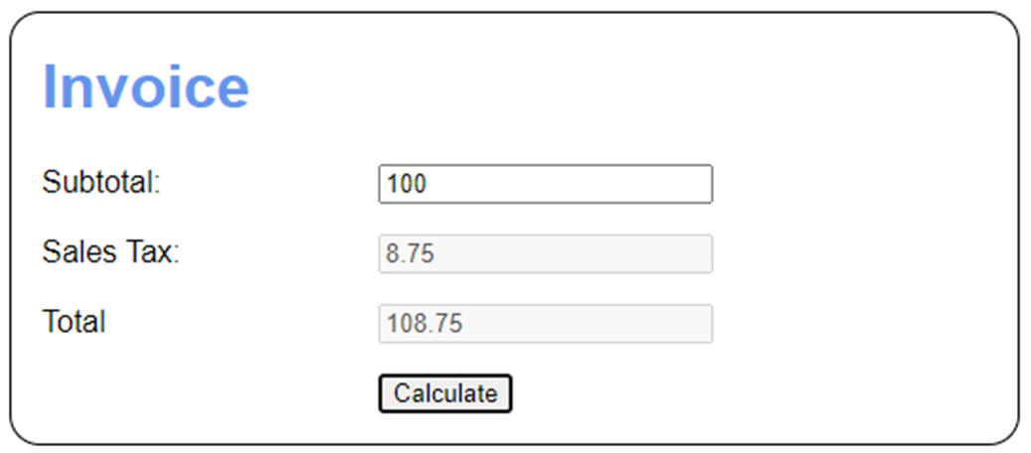
The Invoice app

Slide 15
The <body> element for the Invoice app (part 1)
<body>
<h1>Invoice</h1>
<div>
<label for="subtotal">Subtotal:</label>
<input type="text" id="subtotal">
</div>
<div>
<label for="tax_amount">Sales Tax:</label>
<input type="text" id="tax_amount" disabled>
</div>
<div>
<label for="total">Total</label>
<input type="text" id="total" disabled>
</div>

Slide 16
The <body> element for the Invoice app (part 2)
<div>
<label></label>
<input type="button" id="calculate"
value="Calculate">
</div>
<script src="lib_invoice.js"></script>
<script src="invoice.js"></script>
</body>

Slide 17
The invoice.js file for the Invoice app
"use strict";
const getElement = selector =>
document.querySelector(selector);
document.addEventListener("DOMContentLoaded", () => {
getElement("#calculate").addEventListener(
"click", () => {
const taxRate = 0.0875;
const subtotal =
parseFloat(getElement("#subtotal").value);
const invoice = new Invoice(subtotal, taxRate);
getElement("#tax_amount").value =
invoice.getSalesTax();
getElement("#total").value = invoice.getTotal();
});
});

Slide 18
An Invoice class with a private property and a private method (part 1)
class Invoice {
#subtotal = null; // private property
constructor(subtotal, taxRate) {
this.taxRate = taxRate;
this.#subtotal =
this.#validateSubtotal(subtotal);
}
#validateSubtotal(subtotal) { // private method
if (subtotal <= 0) {
throw new Error(
"Subtotal must be greater than 0.");
} else {
return subtotal;
}
}
setSubtotal(subtotal) {
this.#subtotal = this.#validateSubtotal(subtotal);
}

Slide 19
An Invoice class with a private property and a private method (part 2)
getSubtotal() {
return this.#subtotal;
}
getSalesTax() {
return this.#subtotal * this.taxRate;
}
getTotal() {
return this.getSubtotal() + this.getSalesTax();
}
}

Slide 20
Use public methods to access private fields and methods
const invoice = new Invoice(100, 0.0875);
console.log(invoice.getSubtotal()); // displays 100
invoice.setSubtotal(500);
console.log(invoice.getSubtotal()); // displays 500
invoice.setSubtotal(-100); // throws error

Slide 21
What happens if you try to call a private property or method
console.log(invoice.subtotal); // displays undefined
console.log(invoice.validateSubtotal());
// TypeError: not a function

Slide 22
An Invoice class with accessor properties (part 1)
class Invoice {
#subtotal = null; // private subtotal
constructor(subtotal, taxRate) {
this.taxRate = taxRate;
this.#subtotal =
this.#validateSubtotal(subtotal);
}
#validateSubtotal(subtotal) {
if (subtotal <= 0) {
throw new Error(
"Subtotal must be greater than 0.");
} else {
return subtotal;
}
}
set subtotal(subtotal) { // subtotal setter
this.#subtotal =
this.#validateSubtotal(subtotal);
}

Slide 23
An Invoice class with accessor properties (part 2)
get subtotal() { // subtotal getter
return this.#subtotal;
}
get salesTax() { // read-only property
return this.#subtotal * this.taxRate;
}
get total() { // read-only property
return this.subtotal + this.salesTax;
}
}

Slide 24
Use accessor properties to access private fields and methods
const invoice = new Invoice(100, 0.0875);
console.log(invoice.subtotal); // displays 100
invoice.subtotal = 200; // use setter
console.log(invoice.total); // displays 217.5

Slide 25
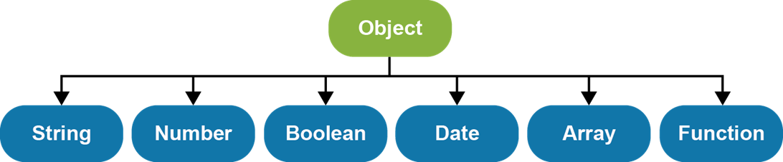
The JavaScript object hierarchy

Slide 26
The Person class
class Person {
constructor(fname, lname) {
this.firstName = fname;
this.lastName = lname;
}
get fullName() {
return `${this.firstName} ${this.lastName}`;
}
}
How to create and use a Person object
const p = new Person("Grace", "Hopper");
console.log(p.fullName); // displays "Grace Hopper"
console.log(p instanceof Object); // displays true
console.log(p instanceof Person); // displays true

Slide 27
An Employee class that inherits the Person class
class Employee extends Person {
constructor(fname, lname, hireDate) {
super(fname, lname);
this.hireDate = hireDate;
}
}
How to create and use an Employee object
const emp = new Employee(
"Bjarne", "Stroustrup", new Date("1/1/1979"));
console.log(emp.fullName); // displays "Bjarne Stroustrup"
console.log(emp.hireDate.toDateString());
// displays "Mon Jan 01 1979"
console.log(emp instanceof Person); // displays true
console.log(emp instanceof Employee); // displays true

Slide 28
Inheritance concepts
Inheritance lets you create a new class based on an existing class. Then, the new class inherits the properties and methods of the existing class.
When you define a class, you can use the extends keyword to inherit the specified class.
A subclass is a class that inherits another class that’s known as a superclass.
When you define a subclass, you can use the super keyword to call constructors and methods of the superclass.
When you work with objects, you can use the instanceof operator to check whether an object is an instance of the specified class.

Slide 29
A NumberArray class that uses inheritance
class NumberArray extends Array {
constructor() {
super();
this.lastNumber = null; // defines a new property
}
push(num) { // overrides an existing method
if(typeof num === "number") {
super.push(num);
this.lastNumber = num;
} else {
throw new TypeError(
"NumberArray can only store numbers");
}
}
}

Slide 30
Code that uses a NumberArray object that inherits the Array object
const arr = new NumberArray();
arr.push(1.07);
arr.push(2.21);
arr.push(3.14);
// arr.push("Grace"); // TypeError
console.log(arr.lastNumber); // displays 3.14
console.log(arr.length); // displays 3
console.log(arr.toString()); // displays 1.07,2.21,3.14
arr.unshift("Grace"); // stores invalid value
A problem with the NumberArray class
Not all inherited methods that add elements to the array check to make sure the element is a number. As a result, it’s possible to add invalid data to the NumberArray object.

Slide 31
It makes sense to use inheritance when…
One object is a type of another object.
Both classes are part of the same logical domain.
The subclass primarily adds features to the superclass.

Slide 32
A NumberArray class that uses object composition (part 1)
class NumberArray {
#numbers = null; // a private property
constructor() {
this.#numbers = []; // initialize private array
this.lastNumber = null;
}
get length() { // a read-only property
return this.#numbers.length;
}

Slide 33
A NumberArray class that uses object composition (part 2)
push(num) { // a method
if(typeof num === "number") {
this.#numbers.push(num);
this.lastNumber = num;
} else {
throw new TypeError(
"NumberArray can only store numbers");
}
}
toString() { // a method
return this.#numbers.toString();
}
}

Slide 34
Code that uses a NumberArray object that uses object composition
const arr = new NumberArray();
arr.push(1.07);
arr.push(2.21);
arr.push(3.14);
// arr.push("Grace"); // Would throw TypeError
console.log(arr.lastNumber); // displays 3.14
console.log(arr.length); // displays 3
console.log(arr.toString()); // displays 1.07,2.21,3.14
// arr.unshift("Grace"); // Would throw TypeError
// because method isn't
// defined

Slide 35
It makes sense to use object composition when…
One object has a type of another object.
The object restricts access to features of the internal object.

Slide 36
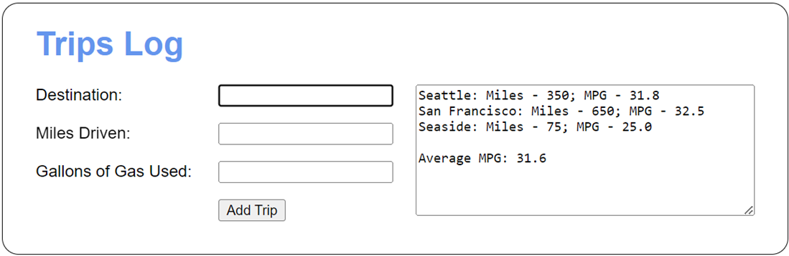
The Trips app

Slide 37
The <body> element for the Trips app (part 1)
<body>
<h1>Trips Log</h1>
<div id="trips">
<textarea id="trip_list" rows="8" cols="42">
</textarea>
</div>
<div>
<label for="destination">Destination:</label>
<input type="text" id="destination">
</div>
<div>
<label for="miles">Miles Driven:</label>
<input type="text" id="miles">
</div>
<div>
<label for="gallons">Gallons of Gas Used:</label>
<input type="text" id="gallons">
</div>

Slide 38
The <body> element for the Trips app (part 2)
<div>
<label></label>
<input type="button" id="add_trip"
value="Add Trip">
</div>
<div>
<span id="msg"></span>
</div>
<script src="lib_trips.js"></script>
<script src="trips.js"></script>
</body>

Slide 39
Some of the CSS for the Trips app
#trips {
float: right;
}

Slide 40
The lib_trips.js file (part 1)
"use strict";
class Trip {
constructor(destination, miles, gallons) {
this.destination = destination;
this.miles = parseFloat(miles);
this.gallons = parseFloat(gallons);
}
get mpg() { // a read-only property
return this.miles / this.gallons;
}
toString() { // override existing method
const mpg = this.mpg.toFixed(1);
return `${this.destination}: Miles –
${this.miles}; MPG - ${mpg}`;
}
}

Slide 41
The lib_trips.js file (part 2)
class Trips {
#trips = null; // a private field
constructor() {
this.#trips = [];
}
push(trip) {
if (trip instanceof Trip) {
this.#trips.push(trip);
} else {
throw new Error("Must be a Trip object.");
}
}

Slide 42
The lib_trips.js file (part 3)
get averageMpg() { // a read-only property
let totalMiles = 0;
let totalGallons = 0;
for (let trip of this.#trips) {
totalMiles += trip.miles;
totalGallons += trip.gallons;
}
return totalMiles / totalGallons;
}
toString() { // override existing method
let str = "";
for (let trip of this.#trips) {
str += trip + "\n";
}
str += "\nAverage MPG: " +
this.averageMpg.toFixed(1);
return str;
}
}

Slide 43
The trips.js file (part 1)
"use strict";
const getElement = selector =>
document.querySelector(selector);
document.addEventListener("DOMContentLoaded", () => {
const trips = new Trips();
getElement("#add_trip").addEventListener(
"click", () => {
const msgElement = getElement("#msg");
msgElement.textContent = "";
const destination =
getElement("#destination").value;
const miles = getElement("#miles").value;
const gallons = getElement("#gallons").value;
const trip = new Trip(
destination, miles, gallons);

Slide 44
The trips.js file (part 2)
if (destination == "" || miles == "" ||
gallons == "") {
msgElement.textContent =
"All fields are required.";
getElement("#destination").focus();
} else if (isNaN(trip.miles) || trip.miles < 0) {
msgElement.textContent =
"Miles must be a valid number greater " + "than zero.";
getElement("#miles").select();
} else if (isNaN(trip.gallons) ||
trip.gallons < 0) {
msgElement.textContent =
"Gallons must be a valid number " +
"greater than zero.";
getElement("#gallons").select();

Slide 45
The trips.js file (part 3)
} else {
trips.push(trip);
getElement("#trip_list").value = trips;
getElement("#destination").value = "";
getElement("#miles").value = "";
getElement("#gallons").value = "";
getElement("#destination").focus();
}
});
getElement("#destination").focus();
});

Slide 46
Two methods that modify an object but don’t return the object
const taskList = {
tasks: [],
load() {
this.tasks = storage.retrieve();
},
add(task) {
this.tasks.push(task);
}
};
The methods must be called one at a time
taskList.load();
taskList.add(task);
Chaining these method calls doesn’t work
taskList.load().add(task);
// TypeError: Cannot read property 'add' of undefined

Slide 47
Two methods that modify an object and then return the object
const taskList = {
tasks: [],
load() {
this.tasks = storage.retrieve();
return this;
},
add(task) {
this.tasks.push(task);
return this;
}
};
Chaining these method calls works
taskList.load().add(task);

Slide 48
An Invoice class with a static property and a static method
class Invoice {
static taxRate = .0875; // static property
static isInvoice(invoice) { // static method
return invoice instanceof Invoice;
}
constructor(subtotal) {
this.subtotal = subtotal;
}
get total() {
return this.subtotal +
(this.subtotal * Invoice.taxRate);
}
}

Slide 49
Call static methods
const inv = new Invoice(100);
if (Invoice.isInvoice(inv)) {
console.log(Invoice.taxRate); // displays 0.0875
console.log(inv.total); // displays 108.75
}
What happens if you try to call a static property or method on an instance of a class
console.log(inv.taxRate); // displays undefined
console.log(inv.isInvoice(inv));
// TypeError: not a function

Slide 50
Code and use a private static property
class Invoice {
static #taxRate = .0875; // private static property
...
get total() {
return this.subtotal +
(this.subtotal * Invoice.#taxRate);
}
...
}

Slide 51
Create nested objects with object literals
const invoice = {
subtotal: 100,
terms: { // nested object
taxRate: 0.0875,
dueDays: 30
},
getTotal() {
return this.subtotal +
(this.subtotal * this.terms.taxRate);
}
};

Slide 52
Create nested objects with classes
The Terms class
class Terms {
constructor(taxRate, dueDays) {
this.taxRate = taxRate;
this.dueDays = dueDays;
}
}
The Invoice class
class Invoice {
constructor(subtotal, terms) {
this.subtotal = subtotal;
this.terms = terms;
}
getTotal() {
return this.subtotal +
(this.subtotal * this.terms.taxRate);
}
}

Slide 53
Create nested objects from the classes
const terms = new Terms(0.0875, 30);
// pass terms object to constructor
const invoice = new Invoice(100, terms);
Refer to a property of a nested object from an instance of the outer object
invoice.terms.dueDays = 45;

Slide 54
A person object with three properties that have values
const person = {
firstName: "Grace",
lastName: "Hopper",
dob: null
};
How to assign property values to variables or constants
// using the same names
const {firstName, lastName} = person;
// using different names
const {firstName: fname, lastName: lname} = person;

Slide 55
How to provide a default value for an assignment
const {firstName, dob = "unknown", age = "unknown"} =
person;
console.log(dob); // displays null
console.log(age); // displays "unknown"

Slide 56
How to destructure an object in the parameter list of a function
const displayGreeting = ({firstName, lastName}) => {
console.log("Hello, " + firstName + " " + lastName);
};
Code that calls the function
displayGreeting(person);
// displays "Hello, Grace Hopper"
displayGreeting();
// TypeError: Cannot destructure property

Slide 57
How to assign property values of a nested object
const {subtotal, terms: {taxRate}} = invoice;

Slide 58
One of the well-known symbols
Symbol.iterator
A keyword that’s used with generator functions
yield

Slide 59
A taskList object that’s iterable
const taskList = {
tasks: [],
// properties and methods of the taskList object
// go here
*[Symbol.iterator]() {
for (let task of this.tasks) {
yield task;
}
}
};
A for-of loop that works with a taskList object
for (const task of taskList) {
console.log(task.description)
}

Slide 60
A Date object that’s iterable
const today = new Date("4/15/2024");
today[Symbol.iterator] = function*() {
yield this.getFullYear();
yield this.getMonth();
yield this.getDate();
yield this.getHours();
yield this.getMinutes();
yield this.getSeconds();
};
Use array destructuring syntax with the Date object
const [year, month, date] = today;
console.log(`${date}-${month + 1}-${year}`);
// displays 15-4-2024

Slide 61
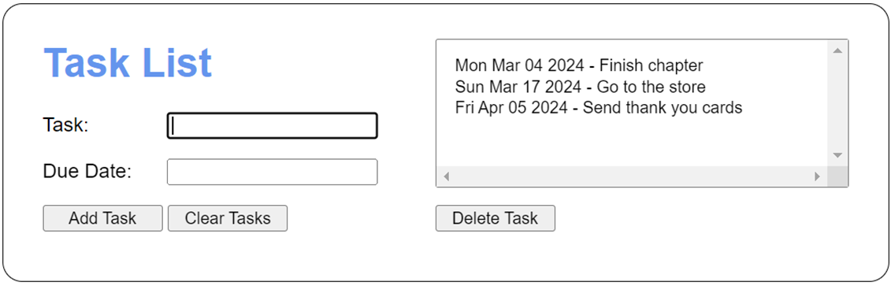
The Task List app

Slide 62
The <body> element for the Task List app (part 1)
<body>
<div id="form">
<h1>Task List</h1>
<div>
<label for="task">Task:</label>
<input type="text" name="task" id="task">
</div>
<div>
<label for="due_date">Due Date:</label>
<input type="text" name="due_date"
id="due_date">
</div>
<button id="add_task">Add Task</button>
<button id="clear_tasks">Clear Tasks</button>
</div>

Slide 63
The <body> element for the Task List app (part 2)
<div id="display">
<select name="tasks" id="tasks" multiple>
</select><br>
<button id="delete_task">Delete Task</button>
</div>
<div class="clear"></div>
<p id="msg"></p>
<script src="lib_task.js"></script>
<script src="lib_storage.js"></script>
<script src="lib_task_list.js"></script>
<script src="task_list.js"></script>
</body>

Slide 64
Some of the CSS for the Task List app
#form { float: left; }
#display { float: right; }
.clear { clear: both; }
select {
overflow-x: scroll;
overflow-y: scroll;
}

Slide 65
The lib_task.js file
class Task {
constructor(description, dueDate) {
this.description = description;
this.dueDate = new Date(dueDate);
}
get hasInvalidDueDate() {
return this.dueDate == "Invalid Date";
}
get isPastDue() {
const today = new Date();
return this.dueDate.getTime() < today.getTime();
}
toString() {
return `${this.dueDate.toDateString()} –
${this.description}`
}
}

Slide 66
The lib_storage.js file
const storage = {
retrieve() {
const tasks = [];
const json = localStorage.tasks;
if(json) {
const taskArray = JSON.parse(json);
for (let obj of taskArray) {
tasks.push(new Task(
obj.description, obj.dueDate));
}
}
return tasks;
},
store(tasks) {
localStorage.tasks = JSON.stringify(tasks);
},
clear() {
localStorage.tasks = "";
}
};

Slide 67
The lib_task_list.js file (part 1)
class TaskList {
#tasks = null;
constructor() {
this.#tasks = [];
}
load() {
this.#tasks = storage.retrieve();
return this;
}
save() {
storage.store(this.#tasks);
return this;
}
sortByDueDate() {
this.#tasks.sort((a, b) =>
a.dueDate - b.dueDate);
return this;
}

Slide 68
The lib_task_list.js file (part 2)
add(task) {
this.#tasks.push(task);
return this;
}
delete(i) {
this.sortByDueDate(); // same order as page
this.#tasks.splice(i, 1);
return this;
}
clear() {
this.#tasks.length = 0;
storage.clear();
return this;
}
*[Symbol.iterator]() {
for (let task of this.#tasks) {
yield task;
}
}
};

Slide 69
The task_list.js file (part 1)
const getElement = selector =>
document.querySelector(selector);
const taskList = new TaskList();
const displayTasks = () => {
taskList.sortByDueDate();
const select = getElement("#tasks");
select.textContent = ""; // clear previous tasks
for (let task of taskList) {
const opt = document.createElement("option");
opt.appendChild(document.createTextNode(task));
select.appendChild(opt);
}
getElement("#task").focus();
};

Slide 70
The task_list.js file (part 2)
document.addEventListener("DOMContentLoaded", () => {
getElement("#add_task").addEventListener(
"click", () => {
getElement("#msg").textContent = "";
const newTask = new Task(
getElement("#task").value,
getElement("#due_date").value);
let message = "";
if (newTask.description === "") {
message = "Task is required. ";
}
if (newTask.hasInvalidDueDate ||
newTask.isPastDue) {
message += "Due Date must be a valid date " +
"in the future."
}

Slide 71
The task_list.js file (part 3)
if (message === "") {
taskList.load().add(newTask).save();
displayTasks();
getElement("#task").value = "";
getElement("#due_date").value = "";
} else {
getElement("#msg").textContent = message;
}
getElement("#task").select();
});
getElement("#clear_tasks").addEventListener(
"click", () => {
taskList.clear();
getElement("#tasks").textContent = "";
getElement("#task").value = "";
getElement("#due_date").value = "";
getElement("#msg").textContent = "";
getElement("#task").focus();
});

Slide 72
The task_list.js file (part 4)
getElement("#delete_task").addEventListener(
"click", () => {
getElement("#msg").textContent = "";
const index = getElement("#tasks").selectedIndex;
if (index === -1) {
getElement("#msg").textContent =
"Please select a task to delete.";
} else {
taskList.load().delete(index).save();
displayTasks();
getElement("#task").focus();
}
});
taskList.load();
displayTasks();
});

